Slide 1
Lecture 9 上机 泊松回归

Slide 2
Example
The number of awards earned by students at one school.
Y： the number of awards
X: (1) the type of program in which the student was enrolled (e.g., A,
B or C)
(2) the average score.

Slide 3
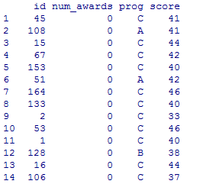
Read in the dataset
dat=read.csv("E:/数据分析和统计软件/Lecture 9 上机数据/data.csv", header=T, sep=',')

Slide 4

Descriptive statistics
tapply(dat$num_awards, dat$prog, mean)
tapply(dat$num_awards, dat$prog, sd)
library(ggplot2)
ggplot(dat, aes(num_awards, fill = prog)) +
geom_histogram(binwidth=.5, position="dodge")
Note: to learn about ggplot: https://www.zhihu.com/question/24779017
color
places the two bars side by side

Slide 5
plot(num_awards~score, data=dat)

Slide 6
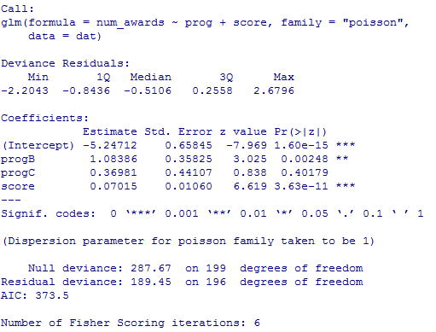
Build Poisson regression model
summary(m1 <- glm(num_awards ~ prog + score, family="poisson", data=dat))

Slide 7
Deviance: A goodness of fit statistic
1-pchisq(m1$deviance, m1$df.residual)
We conclude that the model fits reasonably well

Slide 8
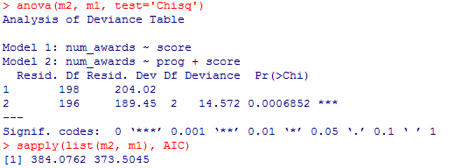
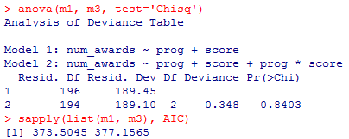
Explore other possible models
summary(m2 <- glm(num_awards ~ score, family="poisson", data=dat))
anova(m2, m1, test='Chisq')
sapply(list(m2, m1), AIC)
summary(m3 <- glm(num_awards ~ prog + score + prog*score, family="poisson", data=dat))
anova(m1, m3, test='Chisq')
sapply(list(m1, m3), AIC)
m1 is winner!

Slide 9
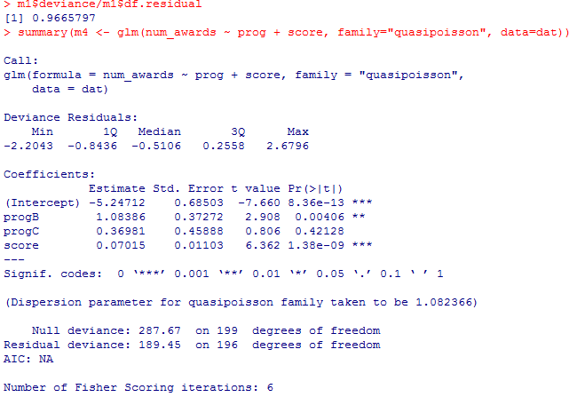
Overdispersion
m1$deviance/m1$df.residual
summary(m4 <- glm(num_awards ~ prog + score, family="quasipoisson", data=dat))

Slide 10
Diagnostic
#deviance residuals
residuals(m1)
#standardized deviance residuals
dev_res=rstandard(m1)
#Pearson’s residuals
residuals(m1, type="pearson")
#standardized Pearson’s residuals
pearson_res=rstandard(m1, type="pearson")
plot(dev_res~m1$fitted)
plot(pearson_res~m1$fitted)
plot(dev_res~score, data=dat)
plot(pearson_res~score, data=dat)
n=dim(dat)[1]
index=seq(1:n)
plot(dev_res~index)
plot((pearson_res~index)
#Q-Q plot
plot(m1, which=c(2))

Slide 11
dfbetas=dfbetas(m1)
dffits=dffits(m1)
cooks=cooks.distance(m1)
cbind(dfbetas,dffits,cooks)
par(mfrow=c(1,2))
plot(dffits~index)
plot(m1, which=c(4))

Slide 12
Interpretation
The Poisson regression model for counts (with a log link) is
log(μ) = x^{T}β i.e., μ=exp(x^{T}β)
exp(β) = with every unit increase in X, the predictor variable has multiplicative effect of exp(β) on the mean of Y.
When program is fixed, for a 10-unit increase in score, the expectation number of awards increase by a factor of exp (0.07015*10)= 2.016776.
When score is fixed, students who are in program B have about 2 (exp (1.08286)= 2.953113) times more expectation number of awards than students who are in program A.

Slide 13
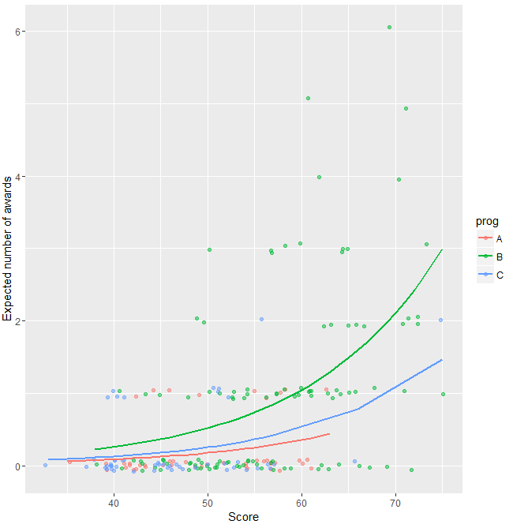
Plot the predicted number of awards against score by prog
## calculate and store predicted values
dat$phat <- predict(m1, type="response")
## order by program and then by math
dat <- dat[with(dat, order(prog, score)), ]
## create the plot
ggplot(dat, aes(x = score, y = phat, colour = prog)) +
geom_point(aes(y = num_awards), position=position_jitter(h=.2)) +
geom_line(size = 1) +
labs(x = "Score", y = "Expected number of awards")
stagger the points

Slide 14
Minitab demo for 0-1回归 and 多分类回归 、

Slide 15
0-1 logistic regression
In the late 1980s, the US Geological Survey (USGS) conducted a water quality study of land on Long Island, New York (Eckhardt et al., 1989). As part of the study, results were presented on contamination of the groundwater by the industrial solvent trichloroethylene (TCE) (工业溶剂三氯乙烯).
We have Y = number of wells (水源) where TCE was detected, out of N sampled wells in total. Also recorded for use as potential predictor variables were:
x_{i1} = land use (with 10 different categories: undeveloped (undev), agriculture (agri), low-density
residential with less than 2 dwellings (房屋)/acre (resL), medium-density residential with
2-4 dwellings/acre (resM), high-density residential with greater than 4 dwellings/acre
(resH), recreation (recr), institution (inst), transportation (trans), commercial (comm), and
industrial (indus))
x_{i2} = whether or not sewers (下水道) were used in the area around the well
x_{i3} = median concentration (mg/L) of nitrate (硝酸盐) at the N well sites
x_{i4} = median concentration (mg/L) of chloride (漂白粉) at the N well sites.
Interest existed in identifying if and how these predictor variables affect TCE contamination.

Slide 16
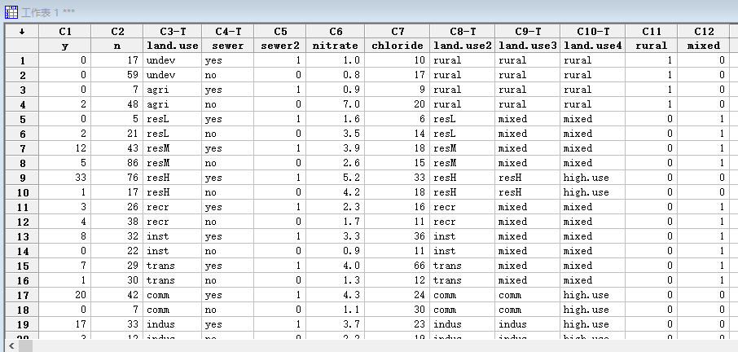

Slide 17
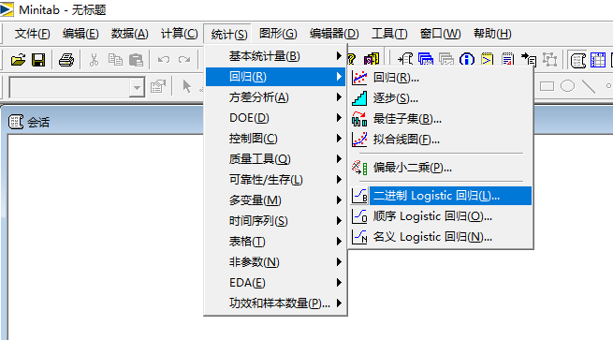
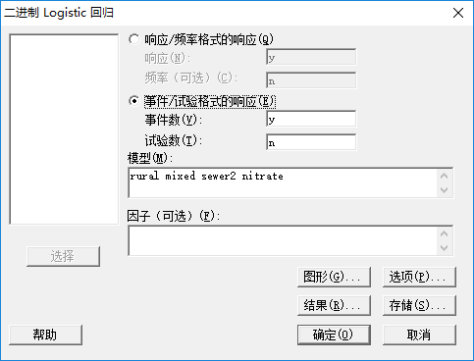
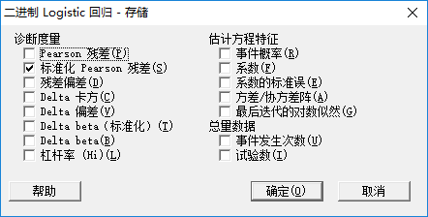

Slide 18
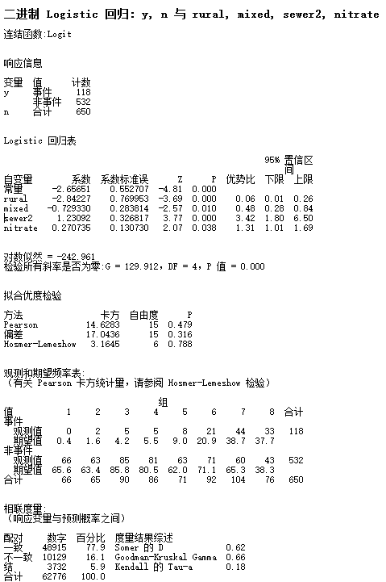
Deviance

Slide 19
Multinomial logistic regression
Entering high school students make program choices
Y: choose from general program, vocational program and academic program.
X: writing score
social economic status.

Slide 20
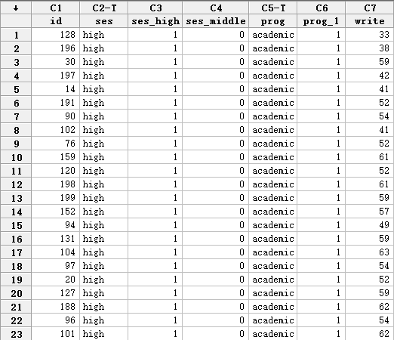

Slide 21
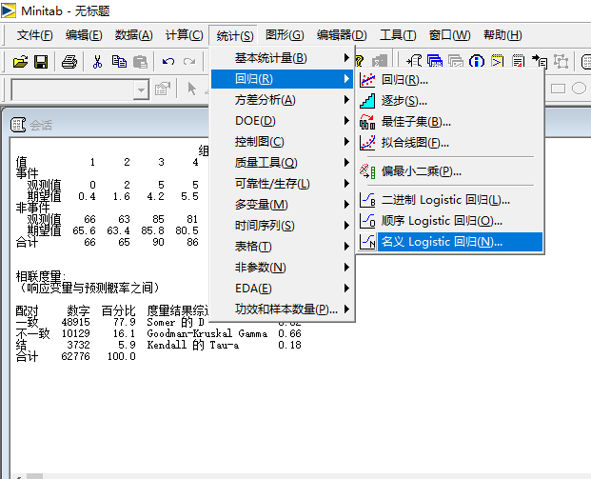
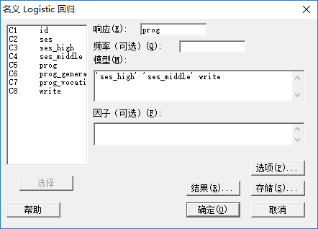
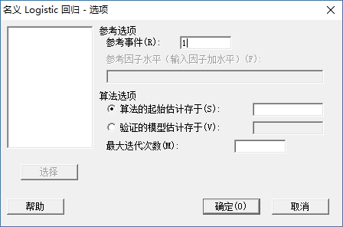

Slide 22
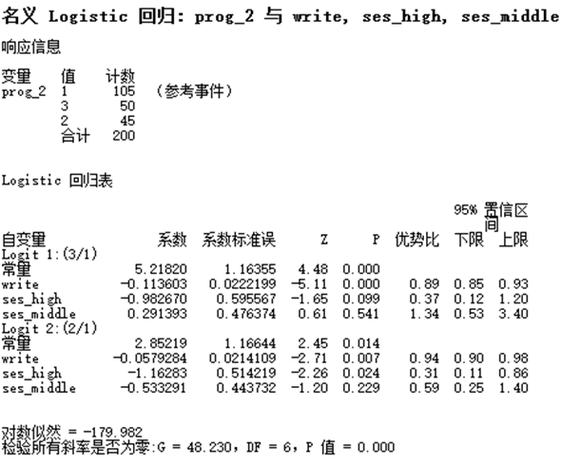

Slide 23
Ordinal logistic regression model
A study looks at factors that influence the decision of whether to apply to graduate school.
Y: College juniors are asked if they are unlikely, somewhat likely, or very likely to apply to graduate school. Hence, our outcome variable has three categories.
X: parental educational status,
whether the undergraduate institution is public or private,
current GPA

Slide 24
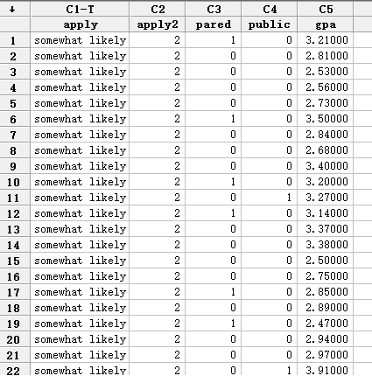

Slide 25
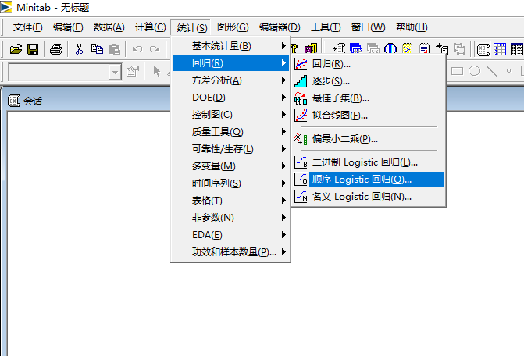
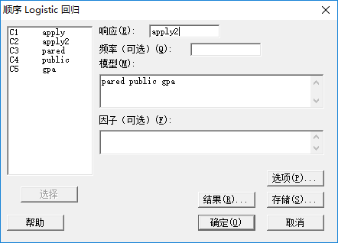

Slide 26
